Slide 1
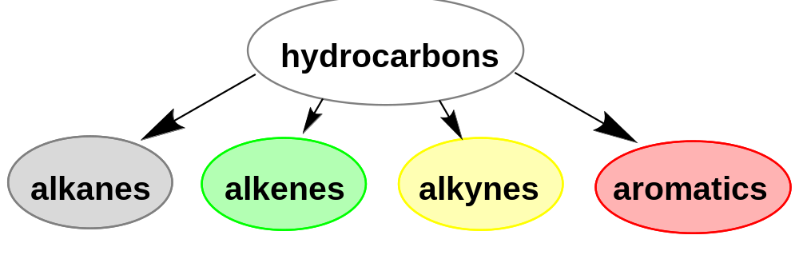
Chapter 6 Aromatic Compounds
6-1 Introduction
Benzene and benzene-related compounds are called aromatic because of some of them were firstly derived from plants with pleasant odors, in contrast to other organic compounds which were called aliphatic, meaning fatlike.
Nowadays the term aromatic has been applied to compounds with benzene or benzene-like structures with unusual stability and reactivity, regardless of their odors.

Slide 2
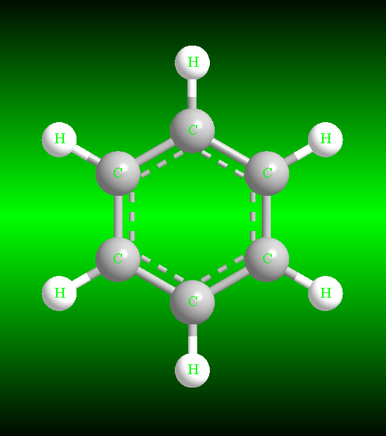
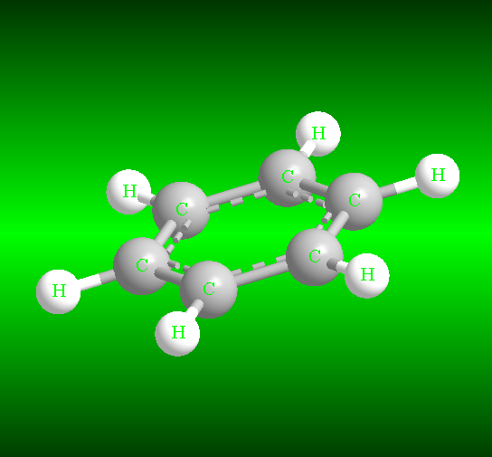
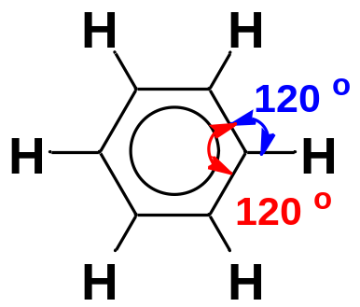
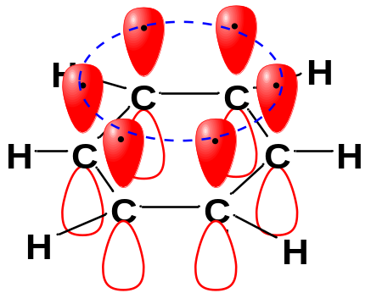
6-2 The Structure and Unusual Stability of Benzene
6-2-1 Spectroscopic facts
Spectroscopic measurements have shown that the benzene ring is a planar hexagon and all the C−C bonds are the same length (1.397 Å). All the bond angles are exactly 120 °.
The carbon-carbon bond lengths in benzene are shorter than typical single-bond lengths (1.48 Å), yet longer than typical double-bond lengths (1.34 Å).
The C−C σ bonds are sp²-sp² overlap, forming the framework of benzene
The C−H bonds are sp²-s overlap
6-2 Explanation of the Hybridization Theory
Benzene is a ring of six sp²-hybrid carbon atoms, each bonded to one H atom.
Each sp² carbon atom has an unhybridized p orbital perpendicular to the plane of the ring. Overlap of these six unhybridized p orbitals forms a cyclic big π bond.
The number of the p electrons in the continuous ring of the π system is 6.

Slide 3
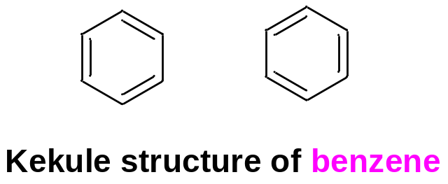
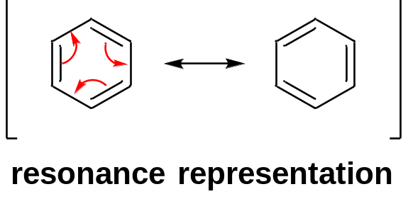
6-2-3 The Kekulé structure
The Kekulé Structure: a cyclic structure with alternating single and double bonds.
We often use Kekulé structures in drawing reaction mechanism to show the movement of electrons.
6-2-4 Explanation of the Resonance Theory
The Resonance Representation: a resonance hybrid of the two Kekulé structures, implying that the π electrons are delocalized.
6-2-5 Physical Properties of Benzene
Benzene is a nonpolar molecule: b.p. 80 °C, density 0.88 g/mL
Benzene and aromatic hydrocarbons are generally insoluble in water.

Slide 4
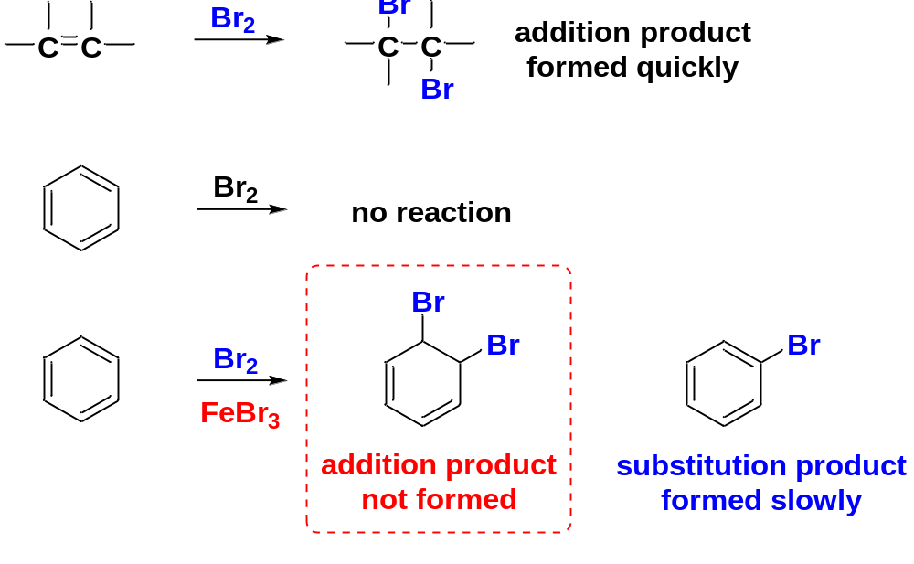
6-2-6 The Unusual Stability and Unusual Reactions of Benzene
When KMnO₄ is added to an alkene, the purple permanganate color disappears, and a precipitate of manganese dioxide forms. When it is added to benzene, however, no reaction occurs.
When Br₂ is added to an alkene, the red bromine color disappears as it adds across the double bond. When it is added to benzene, no reaction occurs, and the red Br₂ color remains.
Addition of a catalyst causes the bromine color to disappear slowly.
The expected addition product is not formed. Instead, the actual product is a substitution of a bromine atom for a hydrogen, and the benzene ring remains.

Slide 5
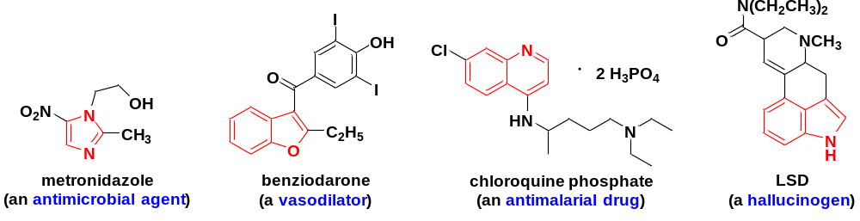

Slide 6
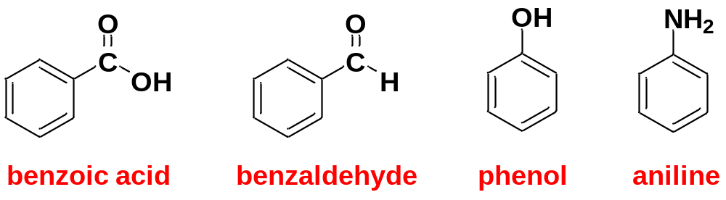
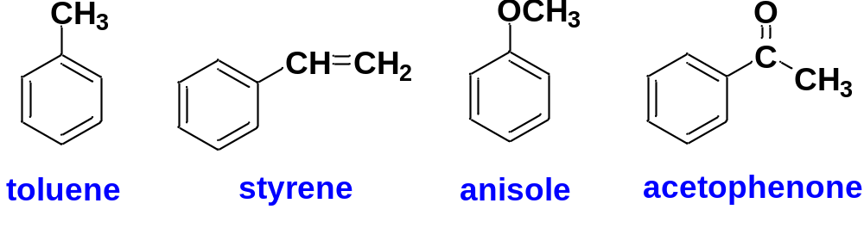
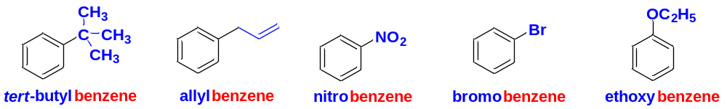
6-3 Nomenclature of Benzene Derivatives
6-3-1 Historical common names
6-3-2 IUPAC names
1> When alkyl, alkenyl, alkynyl, halogen, nitro, alkoxyl groups are attached to the benzene ring, treat them as substituents, use benzene as the base name.
Monosubstituted benzenes

Slide 7
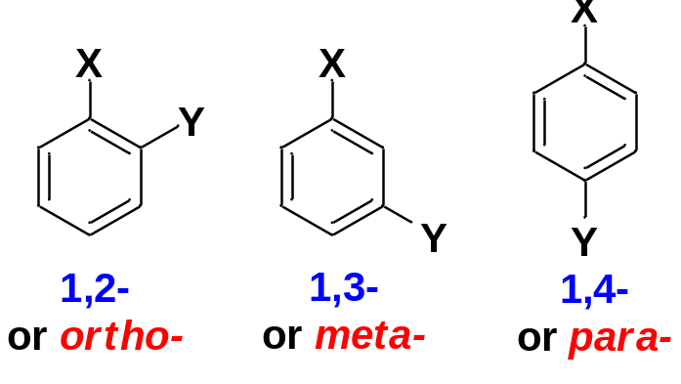
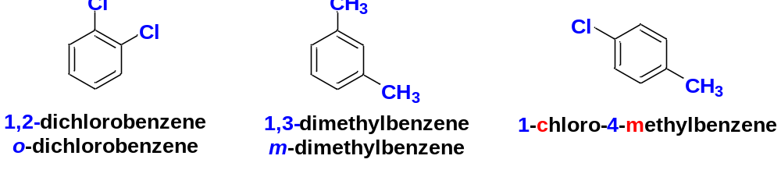
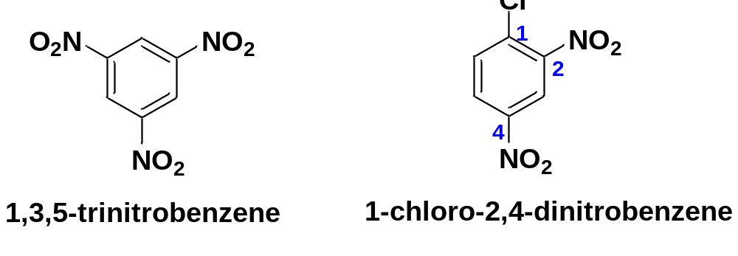
Disubstituted benzenes are named using the prefixes 1,2-(ortho-), 1,3-(meta-) , and 1,4-(para-) to specify the substitution patterns.
Trisubstituted benzenes: keep the numbers of the substituents as low as possible.

Slide 8
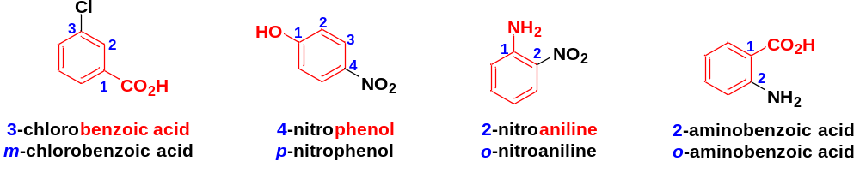
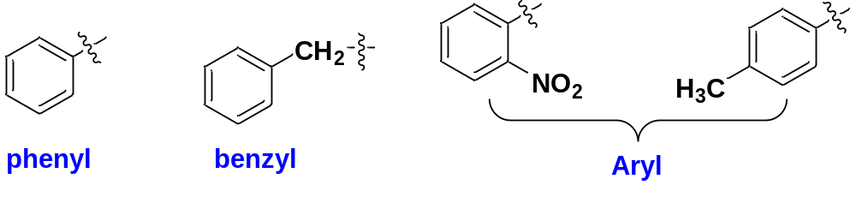
2> When carboxyl, sulfo, formyl, hydroxyl, amino (decreasing priority) groups are attached to the benzene ring, use the historical name represented jointly by benzene and the first priority group as the base name.
6-3-3 Benzene-related groups
Aryl group (Ar): The aromatic group that remains after the removal of a H atom from an aromatic ring.
(generic name)

Slide 9
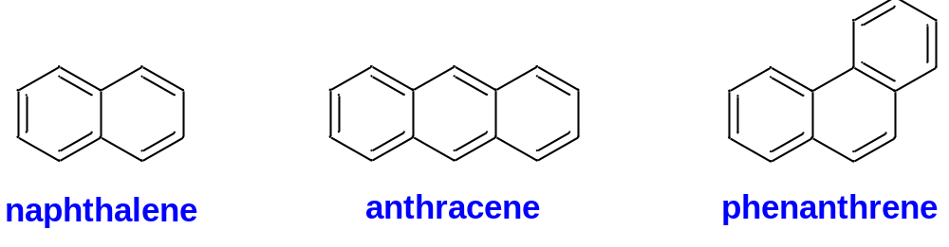
6-3-4 Polynuclear Aromatic Hydrocarbons
The polynuclear aromatic hydrocarbons (PAH) are composed of two or more fused benzene rings.

Slide 10
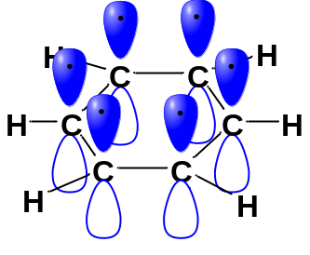
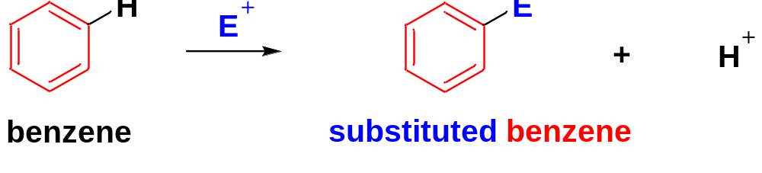
6-4-1 Electrophilic Aromatic Substitution
Like an alkene, benzene has clouds of π electrons above and below its σ bond framework.
Although benzene’s π electrons are in a stable aromatic system, they are available for a strong electrophile and induce the occurrence of electrophilic aromatic substitution.
Electrophilic Aromatic Substitution is the substitution of an electrophile for a proton on the aromatic ring.
A wide variety of electrophilic reagents can be used for EAS.
Because it enables us to introduce functional groups directly onto the aromatic ring through various electrophiles, EAS is the most important method for synthesis of substituted aromatic compounds.

Slide 11
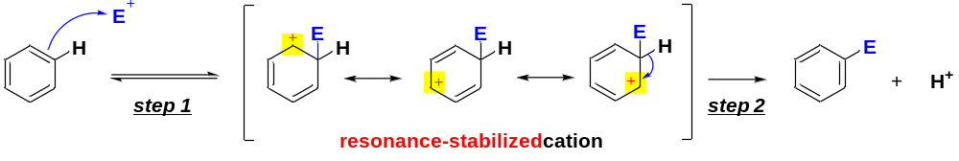
EAS: General Mechanism:
Step 1: Electrophilic Addition: Electrophilic attack by the electrophile forms a resonance-stabilized cation (slow, rate-limiting step, key step).
In step 1, the aromaticity of the benzene ring is lost.
Step 2: Deprotonation: Loss of a proton from the resonance-stabilized carbocation gives the substitution product (fast step).
In step 2, the aromaticity of the benzene ring is regained.
Electrophilic Aromatic Substitution = Electrophilic Addition + Deprotonation

Slide 12
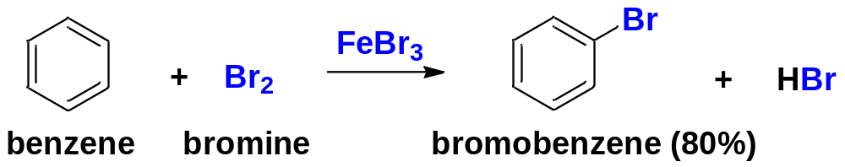
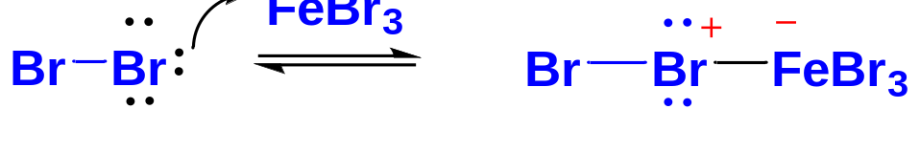
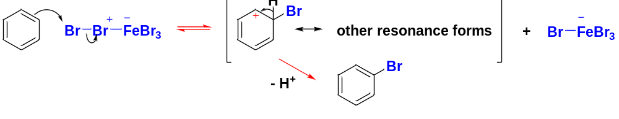
1> Halogenation of Benzene
Bromination
A strong Lewis acid such as FeBr₃ must be added to catalyze the reaction.
The use of the Lewis acid catalyst is to increase the electrophilicity of one Br atom of Br₂
enhanced electrophilicity

Slide 13
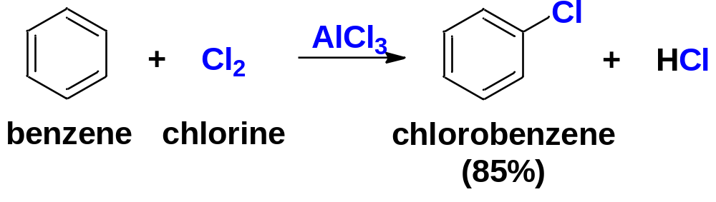
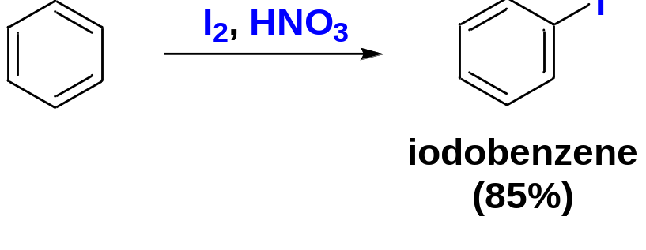
Chlorination
Chlorination of benzene works much like bromination, except that AlCl₃ is most often used as the Lewis acid catalyst.
Iodination
Iodination of benzene requires an acidic oxidizing agent, such as nitric acid. The electrophile is I⁺, produced by oxidation of I₂ with HNO₃.

Slide 14
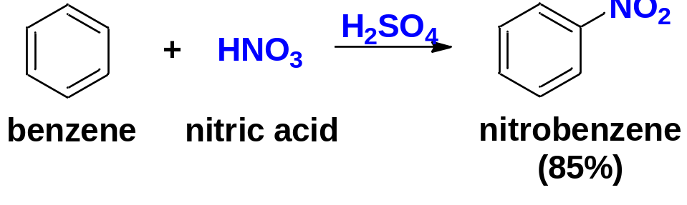
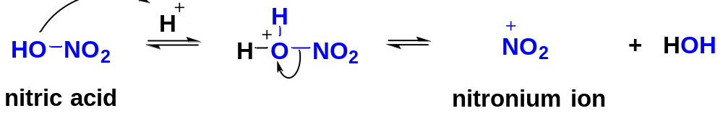
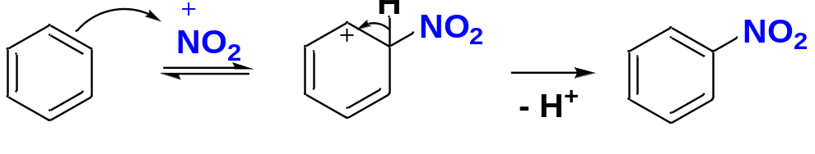
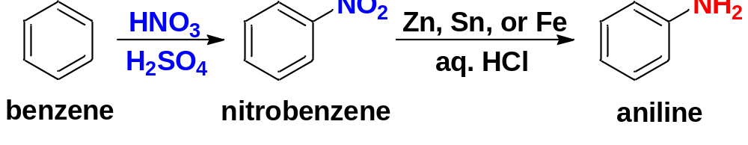
2> Nitration of Benzene
A mixture of nitric acid and sulfuric acid is used for nitration of benzene.
nitration
The electrophile is nitronium ion, formed by reaction of nitric acid with sulfuric acid.
Aromatic nitro groups are easily reduced to amino groups. Nitration followed by reduction is often the best method for adding an amino group to an aromatic ring.

Slide 15
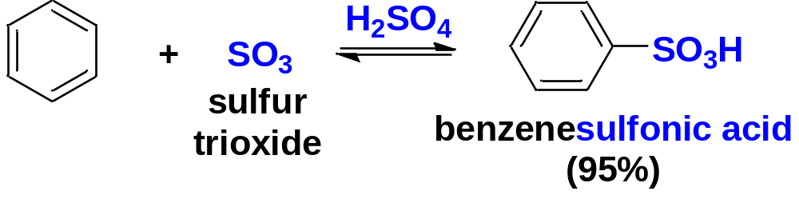
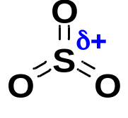
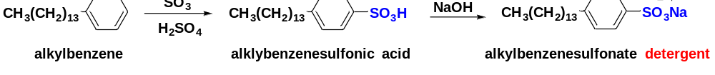
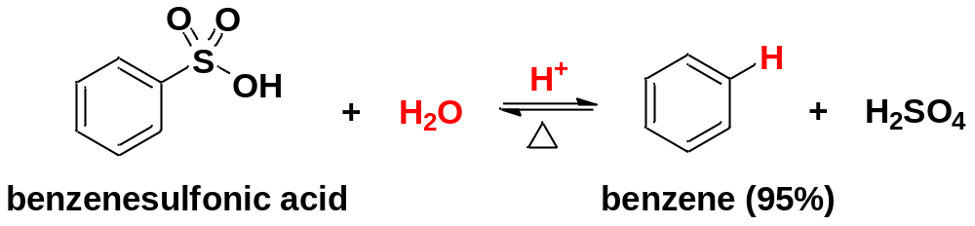
3> Sulfonation of Benzene
Sulfonation
The electrophile is SO₃.
Sulfonation is reversible. A sulfonic acid group may be removed from an aromatic ring by heating in dilute H₂SO₄ (Desulfonation).

Slide 16
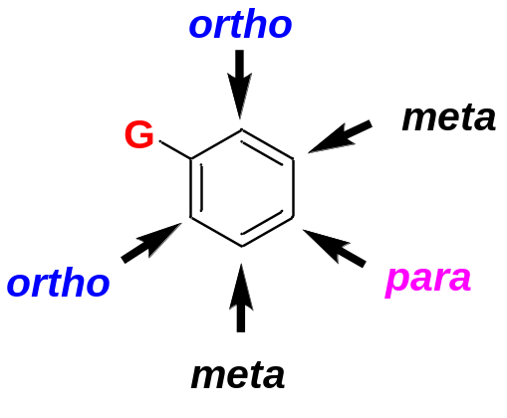
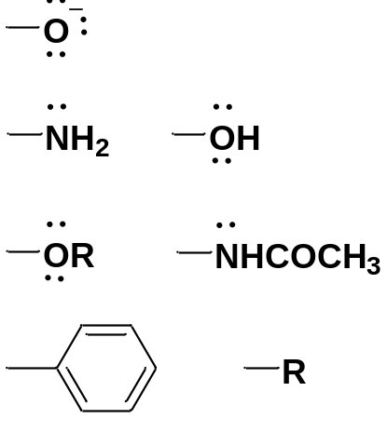
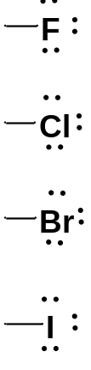
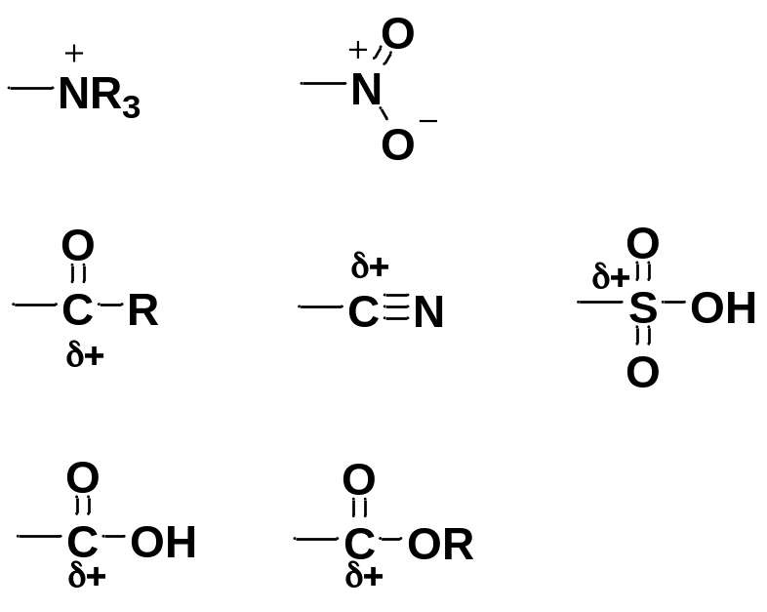
6-5 The Effect of substitution on EAS
Substituents on the benzene ring have a remarkable effect on its reactivity. They also influence the positions of the new functional group introduced by the electrophile.
Regarding EAS, substituents on the benzene ring can be divided into 3 classes.
Ortho : meta : para = 2:2:1 if the electrophile attacks randomly, but this ratio of products isn’t seen in the experimental results
The first class | The second class | The third class
Activating | Moderately Deactivating | Deactivating
Ortho/Para-directing | Ortho/Para-directing | Meta-directing

Slide 17
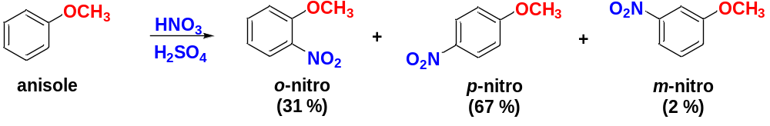
6-5-1 Activating, Ortho, Para-Directors
1> Substituents with Nonbonding Electrons
Methoxybenzene (anisole) undergoes nitration about 10000 times faster than benzene and the methoxyl group of anisole preferentially activates the ortho and para positions.
Alkoxyl Groups
Explanation:
The rate-limiting step for EAS is the formation of the resonance-stabilized cation by electrophilic addition.
This step is where the electrophile bonds to the benzene ring, determining the substitution pattern.

Slide 18
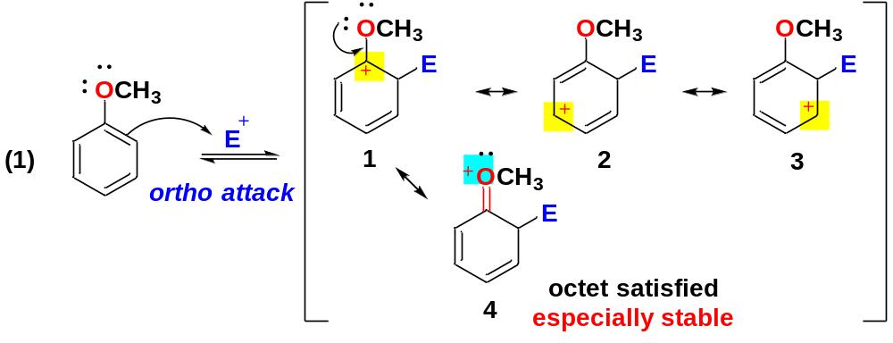
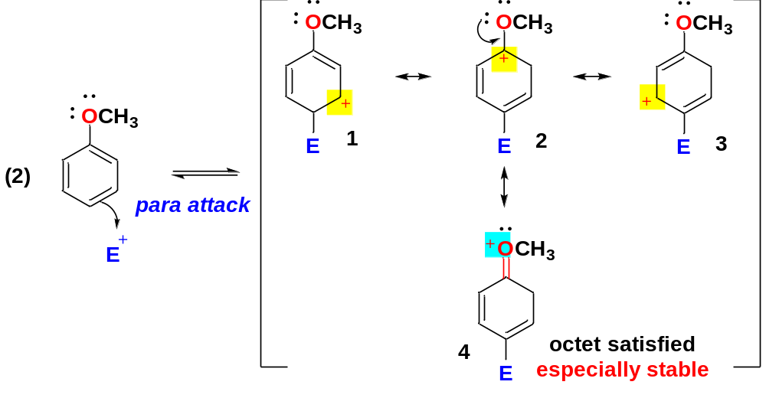
Method of analysis
In the cation resulting from ortho/para attack, the nonbonding electrons of the oxygen atom adjacent to the carbocation stabilize the positive charge through resonance.

Slide 19
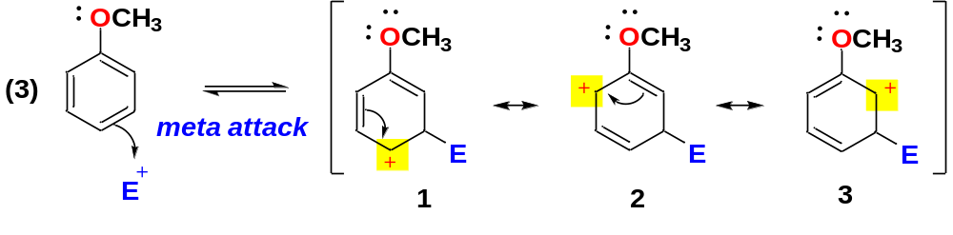
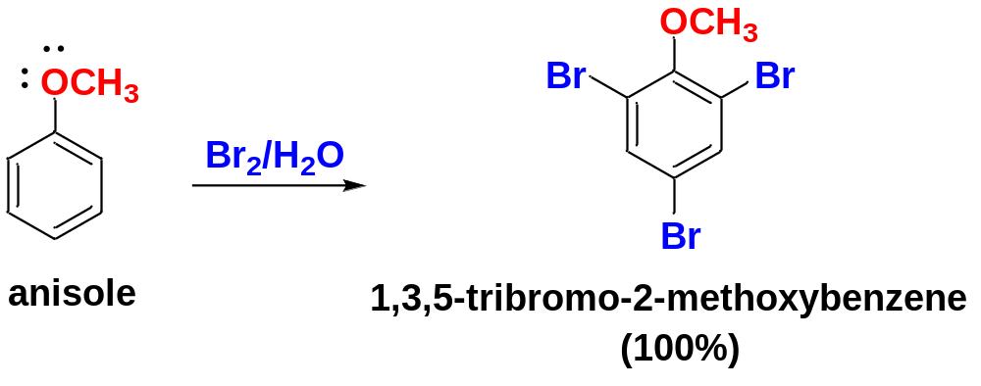
In the cation resulting from meta attack, the nonbonding electrons of the oxygen atom adjacent to the carbocation cannot stabilize the positive charge through resonance.
Because the carbocations resulting from ortho and para attack have the positive charge spread wider (over 3C and 1O) through effective resonance, these carbocations are more stable and formed faster than that from meta attack (the positive charge spread over 3C). Therefore, the ortho and para positions react faster than meta position.
A methoxyl group is so strongly activating that anisole quickly brominates in water without a catalyst.

Slide 20
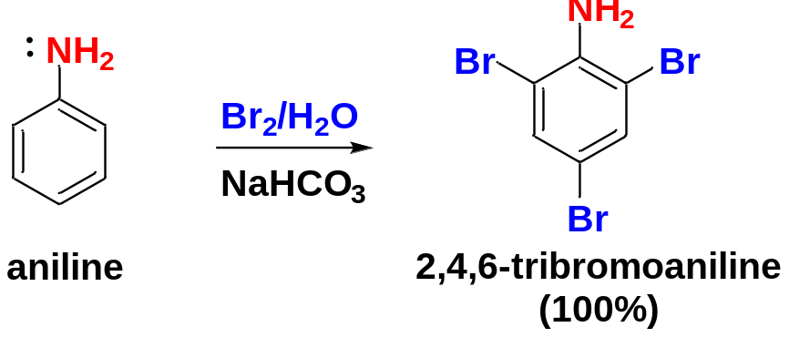
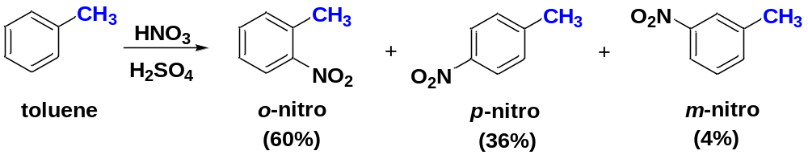
Amino Groups
Like an alkoxyl group, a nitrogen atom with a nonbonding pair of electrons serves as a powerful activating group.
The first class
2> Alkyl Groups without Lone Pairs
Alkyl groups as weak EDG has no lone pairs for resonance and stabilization, they are relatively weak activating substituents, also ortho, para-directing.
Toluene undergoes nitration about 25 times faster than benzene.

Slide 21
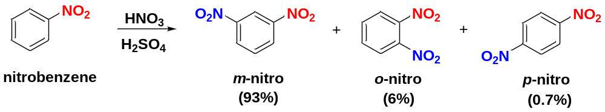
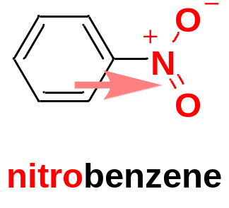
6-5-2 Deactivating, Meta-Directing Substituents
Nitrobenzene is about 100000 times less reactive than benzene toward EAS: the nitro group is a strong deactivating group.
The meta isomer is the major product: the nitro group is a meta-director.
The nitrogen atom of the nitro group has a formal positive charge.
The positively charged nitrogen withdraws electron density from the aromatic ring, making it less electron-rich than benzene, so it is deactivated toward reactions with electrophiles.

Slide 22
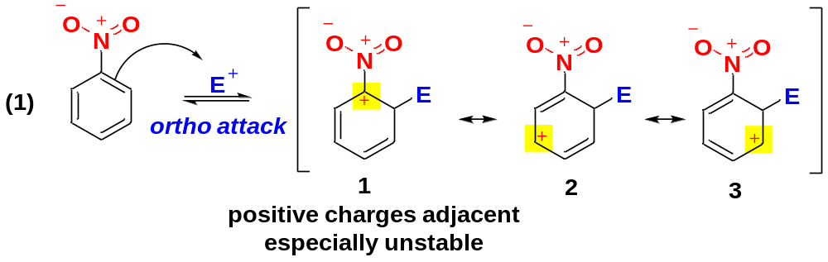
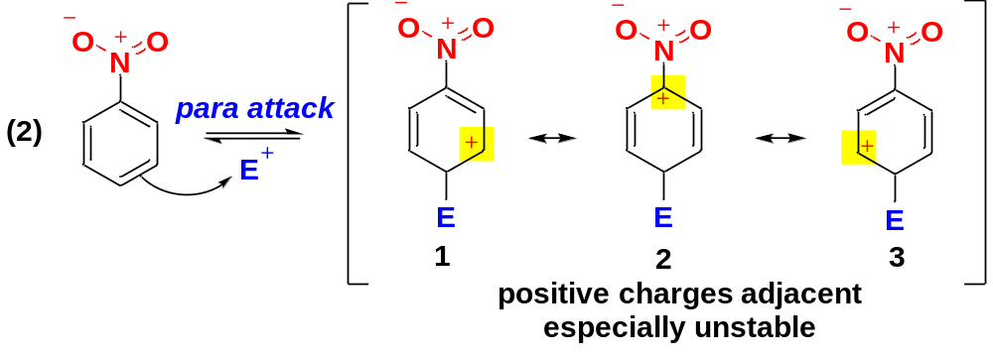
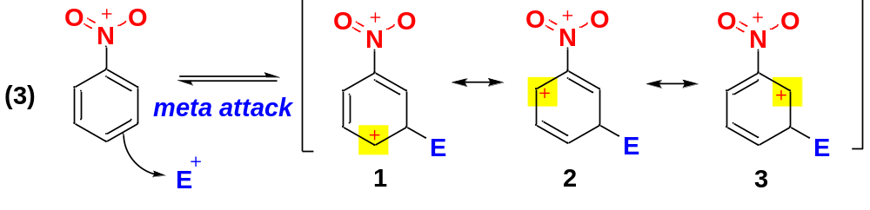
In the cation resulting from ortho/para attack, one resonance form has two positive charges in close proximity. Such a resonance form is very unstable and contributes little to the charge spreading.
For meta substitution, the positive charges are farther apart. The positive charge on the benzene is spread out over 3 carbons (favored).

Slide 23
In general, deactivating, meta-directing substituents are groups with a positive charge (or a partial positive charge) on the atom bonded to the aromatic ring.
The third class
Deactivating, Meta-directing

Slide 24

6-5-3 Deactivating, but Ortho, Para-Directing: Halogen Substituents
The halobenzenes are exceptions to the general rules. Halogens are deactivating groups, yet they are ortho, para-directors.
The halogens are strongly electronegative, withdrawing electron density from the benzene ring: deactivating.
The halogens have nonbonding electrons that can donate electron density to the benzene ring: ortho, para-directing.
These two effects oppose each other.

Slide 25



Slide 26



6-6 Effects of Multiple Substituents on EAS
Two or more substituents exert a combined effect on the reactivity and substitution pattern of an aromatic ring.
If the groups reinforce each other, the result is easy to predict.
The orientation is easily predicted in many cases.

Slide 27



When the directing effects of two or more substituents conflict, it is more difficult to predict the position of the introduced electrophile. In many cases, mixtures result.

Slide 28

When there is a conflict between an activating group and a deactivating group, the activating group usually directs the substitution.
Activating, ortho/para-directing

Slide 29


6-7 The Friedel-Crafts Alkylation and Acylation
6-7-1 The Friedel-Crafts Alkylation
Carbocations are important electrophiles capable of substituting onto aromatic rings.
In the presence of Lewis acid catalysts such as AlCl₃ or FeCl₃, alkyl halides alkylate benzene to give alkylbenzenes.
F-C alkylation forms a new carbon-carbon sigma bond between the benzene ring and the alkyl group.

Slide 30




The F-C alkylation is a typical electrophilic aromatic substitution, with the t-butyl cation acting as the electrophile.
The Lewis acid catalyst is used to help form a carbocation.
Other reaction conditions are also used to form carbocations for the F-C alkylations:
(1) Protonation of alkenes; (2) Treatment of alcohols with BF₃.

Slide 31


6-7-2 Limitations of the Friedel-Crafts Alkylation
Limitation 1: Friedel-Crafts reactions work only with benzene, activated benzene derivatives, and halobenzenes. They fail with strongly deactivated benzenes.
The first class | The second class | The third class
Activating | Moderately Deactivating | Deactivating
Ortho/Para-directing | Ortho/Para-directing | Meta-directing
fail
work

Slide 32


Limitation 2: Like other carbocation reactions, the Friedel-Crafts alkylation is prone to carbocation rearrangements.
n-Propylbenzene cannot be prepared directly by Friedel-Crafts alkylation.
Only certain alkylbenzenes can be made using the F-C alkylation: tert-Butylbenzene, isopropylbenzene, and ethylbenzene can be synthesized by the F-C alkylation because the corresponding cations are not prone to rearrangements.

Slide 33

Limitation 3: Multiple alkylations are hard to avoid because alkyl groups are activating substituents and the product of the Friedel-Crafts alkylation is more reactive than the starting material.
Fortunately, the Friedel-Crafts acylation introduces just one group without danger of polyacylation or rearrangement.

Slide 34



6-7-3 The Friedel-Crafts Acylation
Acyl group: a carbonyl group attached to an alkyl group. Acyl groups are named systematically by dropping the final –e from the alkane name and adding the –oyl suffix.
Acyl chloride: an acyl group bonded to a chlorine atom.
In the presence of AlCl₃, an acyl chloride reacts with benzene to give a phenyl ketone: an acylbenzene.

Slide 35



The F-C acylation is analogous to the F-C alkylation, the electrophile is a resonance-stabilized acylium ion, instead of an alkyl carbocation.
The acylbenzene product is strongly deactivated by the powerful EWG acyl group, therefore the acylation stops after one substitution.
The acylium ion does not rearrange. Therefore, no rearrangements occur.
F-C acylation is much more reliable and useful than F-C alkylation.

Slide 36

Para substitution usually prevails when the aromatic substrate has an ortho, para-directing group, because the electrophile is too bulky for effective attack at the ortho position.
Steric hindrance
(ortho attack disfavored)

Slide 37

6-8 Addition Reactions of Benzene
Although substitution is more common, aromatic compounds may undergo addition reactions if forcing conditions are used.
Catalytic Hydrogenation
Free-Radical Chlorination
Birch Reduction provides a convenient method for making a wide variety of interesting and useful nonconjugated cyclic dienes.

Slide 38



6-9 Side-Chain Reactions of Benzene Derivatives
The reactivity of the side chain of a benzene ring can be promoted by the nearby aromatic ring.
6-9-1 Permanganate Oxidation
Carbon-containing side chains of the aromatic rings may be converted to carboxyl groups by a vigorous permanganate oxidation or chromic acid oxidation.

Slide 39



6-9-2 Benzylic Halogenation
Alkylbenzenes undergo free-radical halogenation much more easily than alkanes because abstraction of a hydrogen atom at the benzylic position gives a resonance-stabilized benzylic radical.
Mechanism: Free-radical halogenation (resembles free-radical halogenation of alkenes).

